Slide 1
PYTHON PROGRAMMING & DATA SCIENCE

Slide 2

Convolutional Neural Networks (CNN)
Convolutional Neural Networks (CNN)
A Convolutional Neural Network or CNN is a type of artificial neural network, which is widely used for image/object recognition and classification.
Deep Learning recognizes objects in an image by using a CNN.
CNN image classifications takes an input image, process it and classify it under certain categories (Eg., Dog, Cat, Tiger, Lion).
Deep learning CNN models to train and test, each input image will pass it through a series of convolution layers with filters (Kernals), Pooling, fully connected layers (FC) and apply Softmax function to classify an object with probabilistic values between 0 and 1.

Slide 3
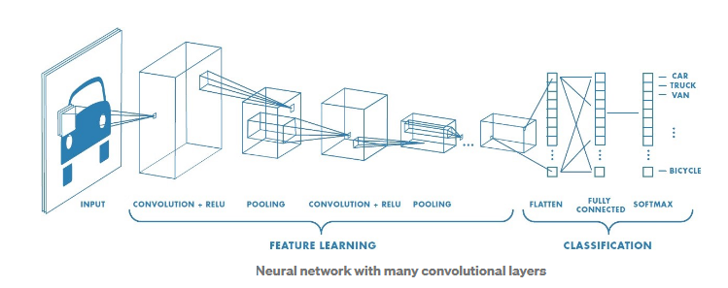
Convolutional Neural Networks (CNN)
Convolutional Neural Networks (CNN)
The complete flow of CNN to process an input image and classifies the objects based on values is as follows.

Slide 4
Convolutional Neural Networks (CNN)
Convolution Layer:
Convolution is the first layer to extract features from an input image.
Convolution preserves the relationship between pixels by learning image features using small squares of input data.
It is a mathematical operation that takes two inputs such as image matrix and a filter or kernel.
CNNs perform convolutions on the image data using a filter or kernel, then produce a feature map.

Slide 5
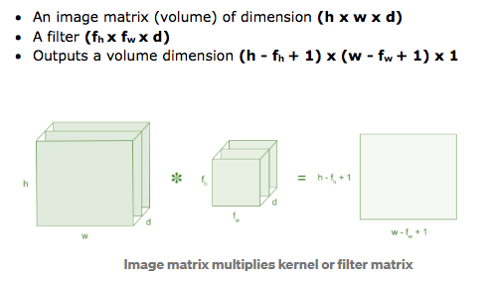
Convolutional Neural Networks (CNN)
Convolution Layer:
In generally,

Slide 6
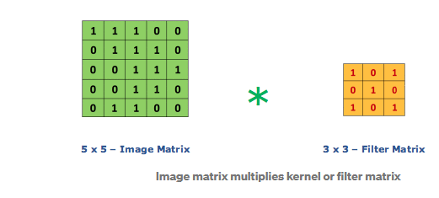
Convolutional Neural Networks (CNN)
Convolution Layer:
Consider a 5 x 5 whose image pixel values are 0, 1 and filter matrix 3 x 3 as shown in below
The convolution of 5 x 5 image
matrix multiplies with 3 x 3 filter
matrix which is called “Feature Map”
as output shown in below

Slide 7
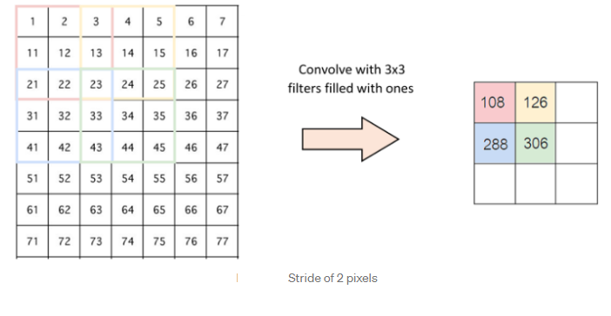
Convolutional Neural Networks (CNN)
Convolution of an image with different filters can perform operations such as edge detection, blur and sharpen by applying filters.
Strides:
Stride is the number of pixels shifts over the input matrix.
When the stride is 1 then we move the filters to 1 pixel at a time. When the stride is 2 then we move the filters to 2 pixels at a time and so on. The below figure shows convolution would work with a stride of 2.

Slide 8
Convolutional Neural Networks (CNN)
Padding:
Sometimes filter does not fit perfectly fit the input image.
We have two options:
Pad the picture with zeros (zero-padding) so that it fits.
Drop the part of the image where the filter did not fit. This is called valid padding which keeps only valid part of the image.
Non Linearity (ReLU):
ReLU stands for Rectified Linear Unit for a non-linear operation. The output is ƒ(x) = max(0,x).

Slide 9
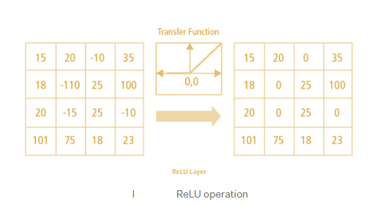
Convolutional Neural Networks (CNN)
ReLU’s purpose is to introduce non-linearity in our ConvNet. Since, the real world data would want our ConvNet to learn would be non-negative linear values.
There are other non linear functions such as tanh or sigmoid that can also be used instead of ReLU.
Most of the data scientists use ReLU since performance wise ReLU is better than the other two.

Slide 10
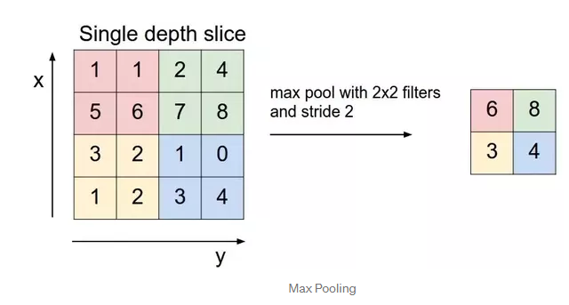
Convolutional Neural Networks (CNN)
Pooling Layer:
Pooling layers section would reduce the number of parameters when the images are too large. Spatial pooling also called subsampling or downsampling which reduces the dimensionality of each map but retains important information. Spatial pooling can be of different types:
Max Pooling
Average Pooling
Sum Pooling
Max pooling takes the largest element from the rectified feature map. Taking the largest element could also take the average pooling. Sum of all elements in the feature map call as sum pooling.

Slide 11
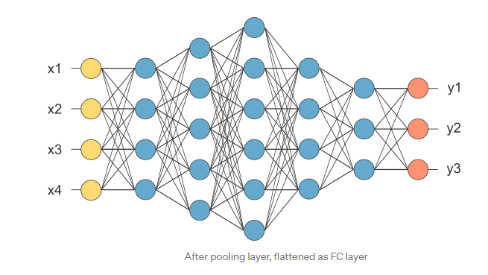
Convolutional Neural Networks (CNN)
Fully Connected Layer:
It is called as FC layer, we flattened our matrix into vector and feed it into a fully connected layer like a neural network.
the feature map matrix will be converted as vector (x1, x2, x3, …). With the fully connected layers, we combined these features together to create a model.

Slide 12
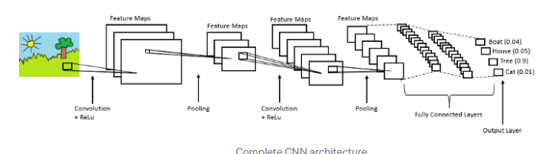
Convolutional Neural Networks (CNN)
Finally, we have an activation function such as softmax or sigmoid to classify the outputs as cat, dog, car, truck etc.,

Slide 13
Convolutional Neural Networks (CNN)
some popular CNN architectures are AlexNet, VGGNet, GoogLeNet, and ResNet.
Procedure to implement CNN :
Provide input image into convolution layer
Choose parameters, apply filters with strides, padding if requires. Perform convolution on the image and apply ReLU activation to the matrix.
Perform pooling to reduce dimensionality size
Add as many convolutional layers until satisfied
Flatten the output and feed into a fully connected layer (FC Layer)
Output the class using an activation function (Logistic Regression with cost functions) and classifies images.

